Slide 1
Improvement focus:
Thinking about: entering cases, finding missing cases or data, communicating results.
In your tables:
Q1. How do you approach this?
Who does it? When do they do it?
Q2. What works well for you?
Q3. What do you find difficult?
Be ready to feedback your main points to the room in 15 mins.

Slide 2




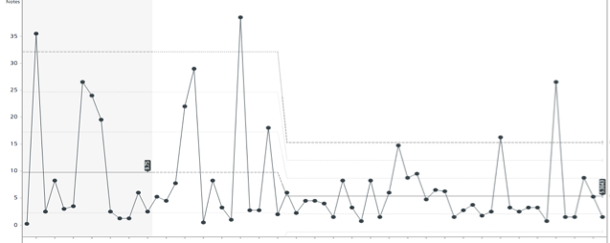

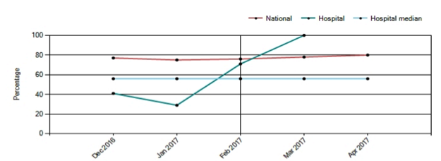

Example of data feedback as infographic
Emergency laparotomy at SGH- how are we doing?
Feb & Mar
We did 22 emergency laparotomies in Feb and Mar
(34 in Dec/Jan)
64 % of cases were entered into NELA
(88% in Oct/Nov)
Post op destinations:
All ‘immediate’ and ‘urgent’ category patients got to theatres within the target time. Since December, 82% patients have arrived in theatres within their target time, and the average time is getting shorter
Time taken to get to theatre from booking
Risk prediction has vastly improved since December, and is now above the national average. Well done everyone!! Please carry on discussing risk at booking: ITU admission and other aspects of care depend on this
Next month’s focus: Risk scoring has improved greatly, but data entry has slipped. Please ensure someone in the team completes the NELA webform, this is vital to good quality data.

Slide 3
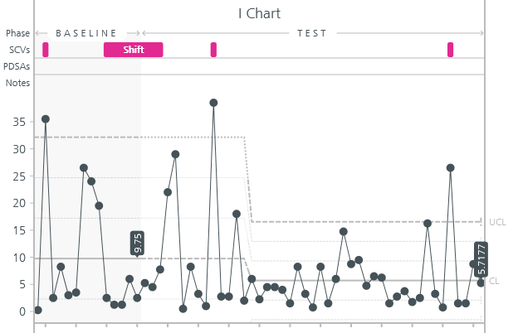
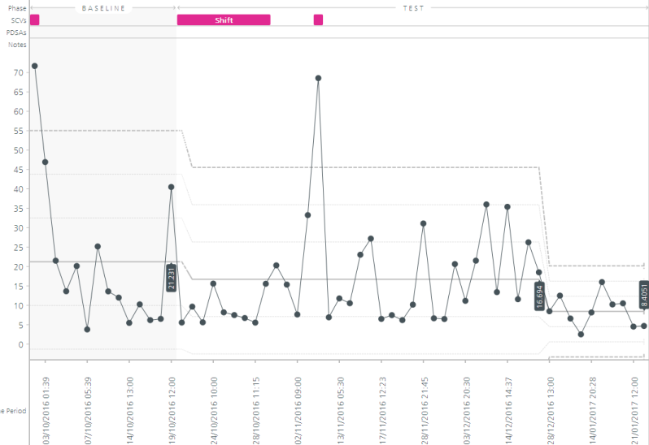
Example of data feedback board report
Metric | CQC domain | Performance and comments
Case ascertainment- completion of audit data is assessed annually and RAG rated against HES data | Well led | 2015- 13%, 2016- 128% (more cases recorded in NELA than HES) Consistent monthly performance ~80% data captured in perioperative period, other cases recorded retrospectively from notes review
Pre operative documentation of risk of death Patients should have objective risk scoring, to guide intra-operative and post operative management | Effective | 40% patients in Feb- Mar meet this standard, improved from 20% in Jan. Theatreman booking form now amended to include risk scoring, training and awareness sessions
Access to theatres in appropriate timescale NCEPOD urgent classification cases- access in <6 hours, NCEPOD immediate- <2 hours | Responsive | See SPC chart. Outliers case notes and theatre schedule review underway. 70% patients currently meeting NCEPOD standard,
Cases >5% predicted mortality with consultant surgeon and anaesthetist present in theatres | Effective | 90% cases meet this standard. This has been consistent over many months
Cases >10% predicted mortality) admitted to high dependency | Safe | GICU aim to take patients with risk of death >5%, 100% patients meeting admission internal standard
Length of stay | Not reported to CQC | See SPC chart, average >15 days, with significant proportion of patients staying >25 days.
Mortality | Effective | In hospital mortality 10.3% (awaiting risk adjustment), 2015 risk adjusted mortality falls within expected range, 11.3%
SPC chart of theatre access times- urgent cases
SPC chart of length of stay

Slide 4
Improvement focus:
Thinking about: Pre op care- sepsis, risk prediction, CT scan access, pre op reviews.
In your tables:
How do you approach this?
Is there a sepsis pathway? How do you build risk prediction into your work? Do you have special access to CT scans?
What works well for you?
What do you find difficult?
Be ready to feedback your main points to the room in 15 mins.

Slide 5
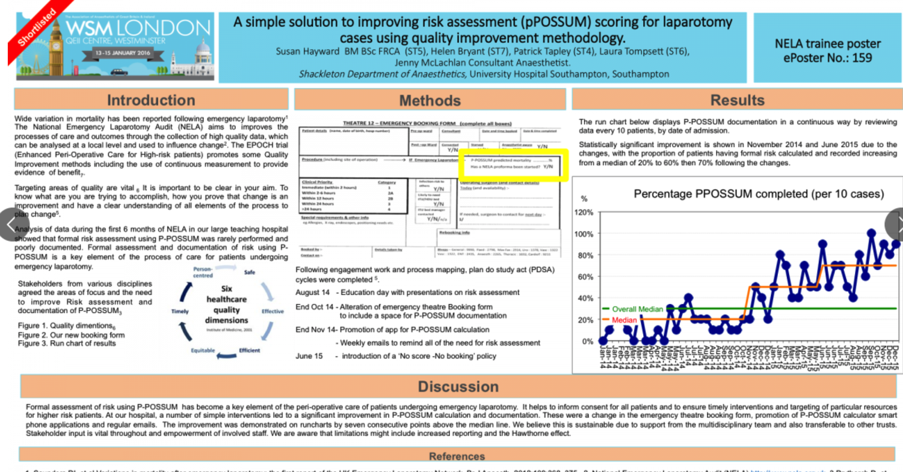
Example of using run charts to inform improvements from AAGBI WSM poster prize winner

Slide 6

Coffee break: back at 14:55

Slide 7
Improvement focus:
Thinking about: periop and post op care- quick access to theatre, ITU admission, elderly care liaison, ward care
In your tables:
How do you approach this?
How do you work with theatres and ITU on EmLaps? Do you have any elderly care liaison? Do you do have any enhanced recovery for emergencies?
What works well for you?
What do you find difficult?
Be ready to feedback your main points to the room in 15 mins.

Slide 8
Quick guide to building a case for elderly care
Define caseload using historic NELA data- how many >70s/week?
Ask CoE about likely provision e.g. 1PA/2PA etc depending on need
Look at length of stay for >70s (it is likely this is long!) Use this to make a case for CoE to reduce impatient stay (can use orthogeris or vascular liaison as an example)
Many resources on British Geriatric society webpage bgs.org.uk

Slide 9

Over to you…..

Slide 10
Thank you
We will share slides from the day via email
We will also collate the best practice examples into a ‘top tips’ document after the 5 workshops this year
Please hand in your feedback forms!
info@nela.org.uk

